Slide 1
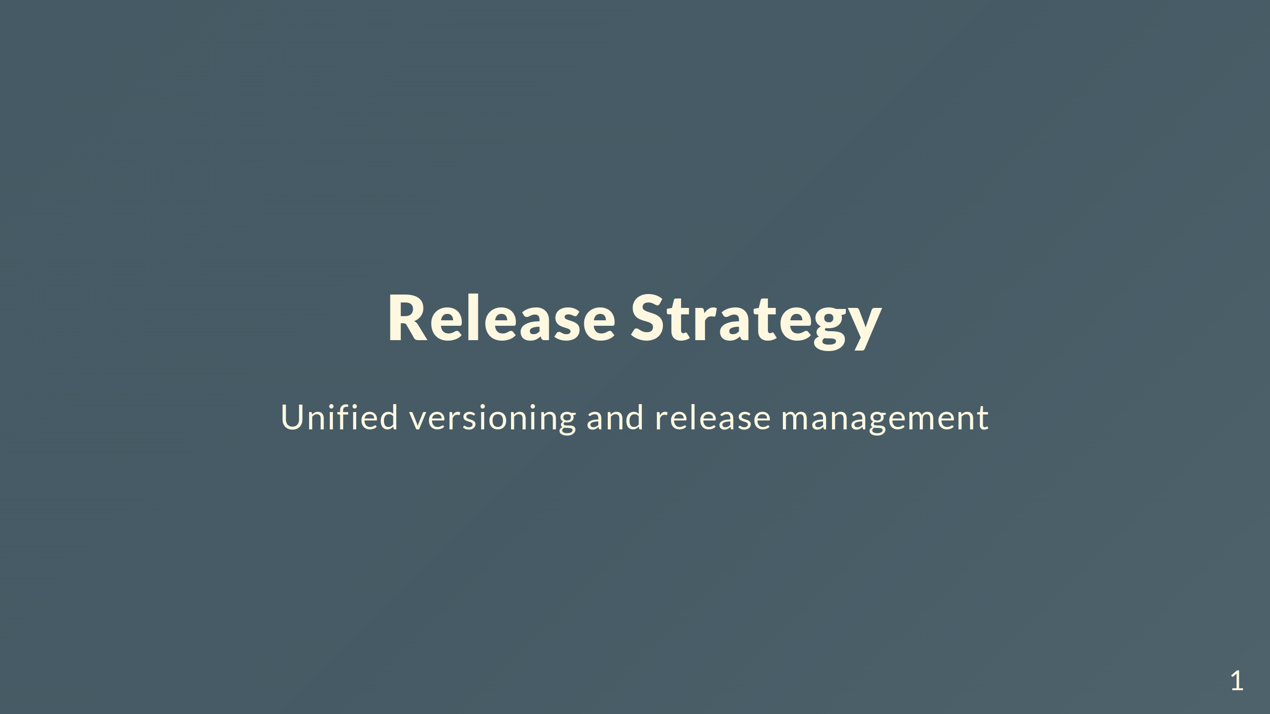
Notes:
Talking about our new release strategy. Moving from release-please to a more explicit approach with unified versioning. Let's start with how things work now.

Slide 2
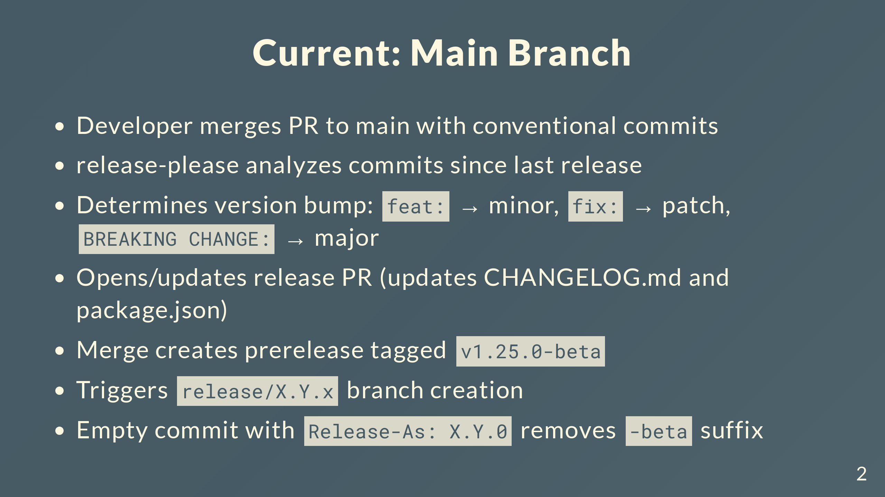
Notes:
Devs use conventional commits - feat, fix, chore, etc. release-please scans commits since last release and figures out the bump. Opens a PR updating changelog and package.json. Merge that PR and it creates a prerelease with -beta, like v1.25.0-beta. Triggers a workflow to create the release branch. Empty commit with Release-As strips the -beta and makes it stable.

Slide 3
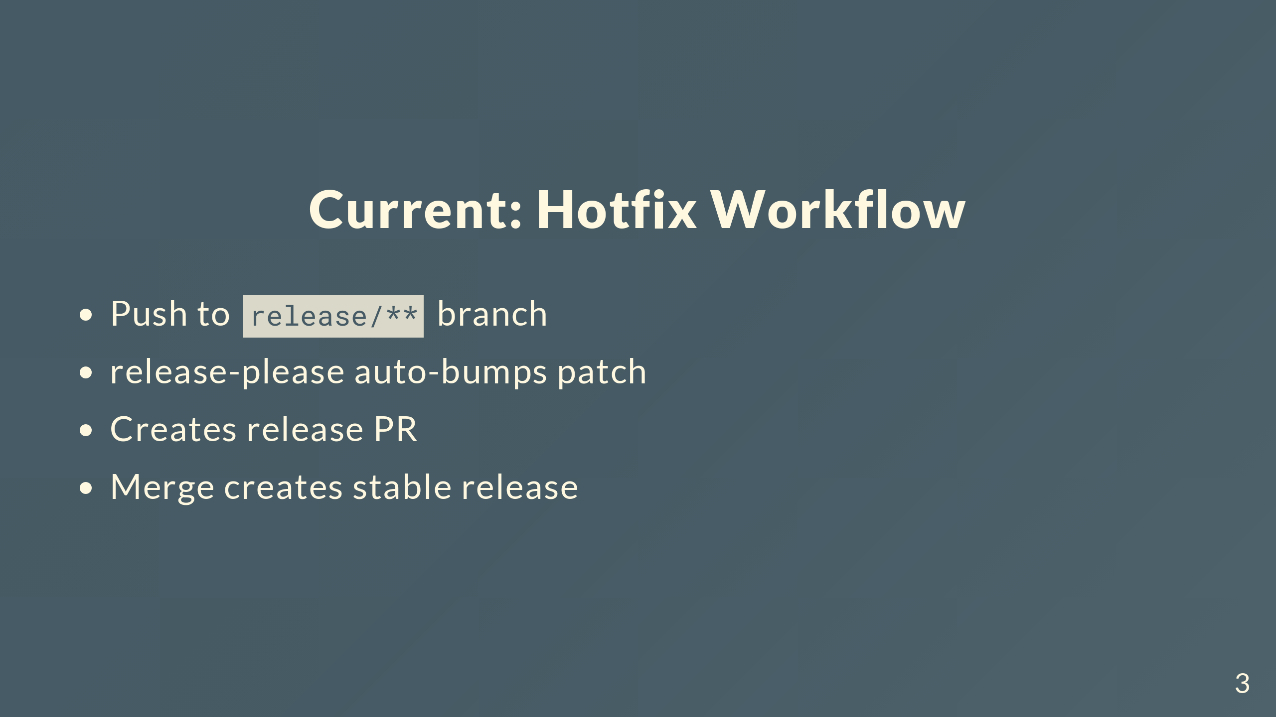
Notes:
For hotfixes, push to release branches and release-please auto-bumps patch. Automation's been helpful but has limitations we'll get into.

Slide 4
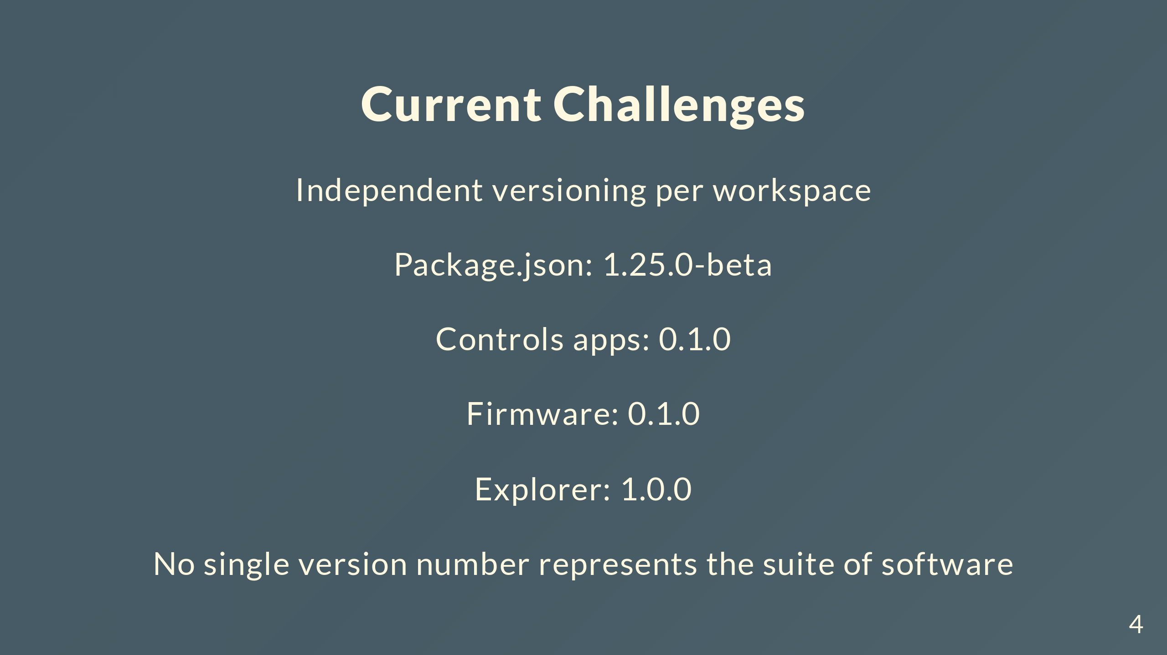
Notes:
Main issue is compatibility tracking. Someone asks "what firmware works with explorer 1.0.0?" - can't give a straight answer because each workspace versions independently. Need a single version representing the whole system state.

Slide 5
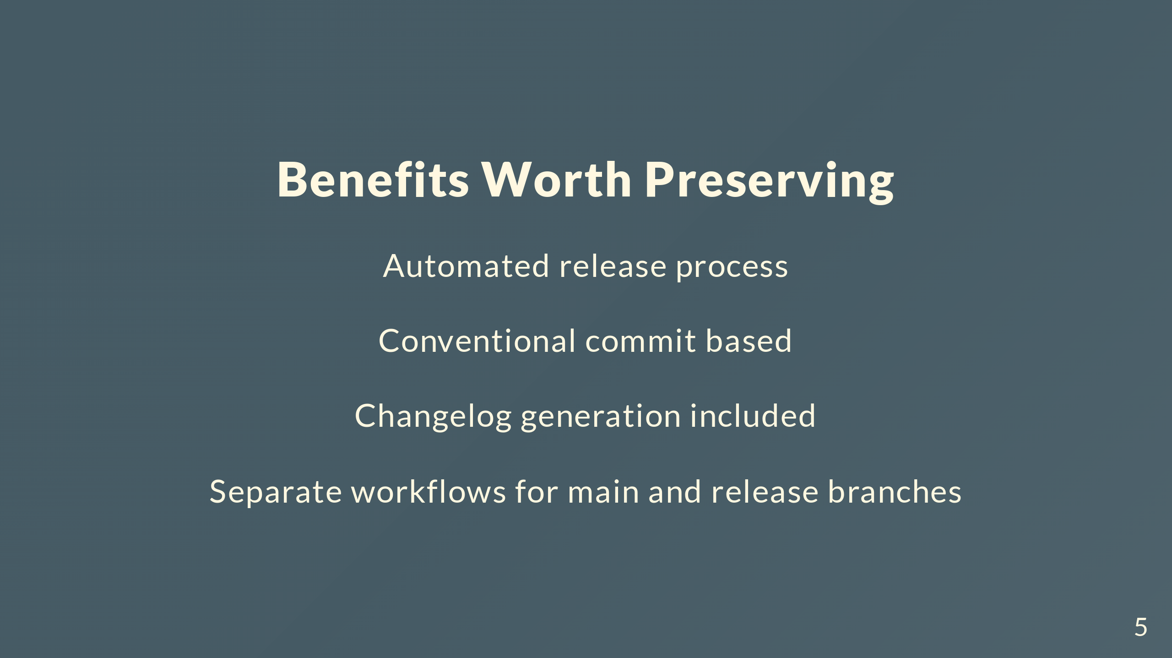
Notes:
Current setup has things worth keeping. Automated changelogs and version updates save time. Conventional commits keep things consistent. Main and release branch workflows make sense. Want to preserve these while fixing the versioning issue.

Slide 6
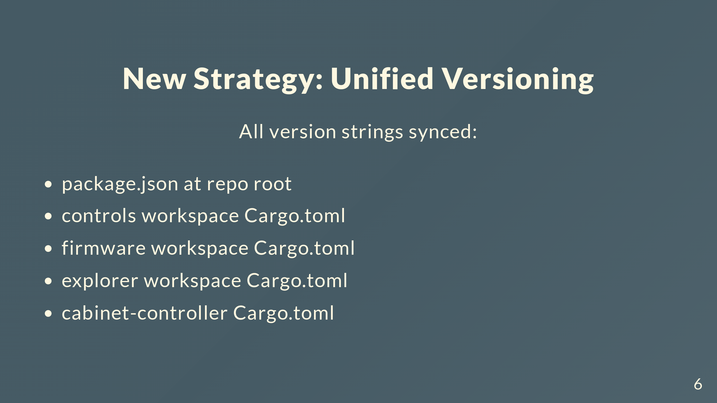
Notes:
Simple: one version for everything. All 5 locations stay synced. Say "version 1.26.0" and you know exactly what you're getting across all components.

Slide 7
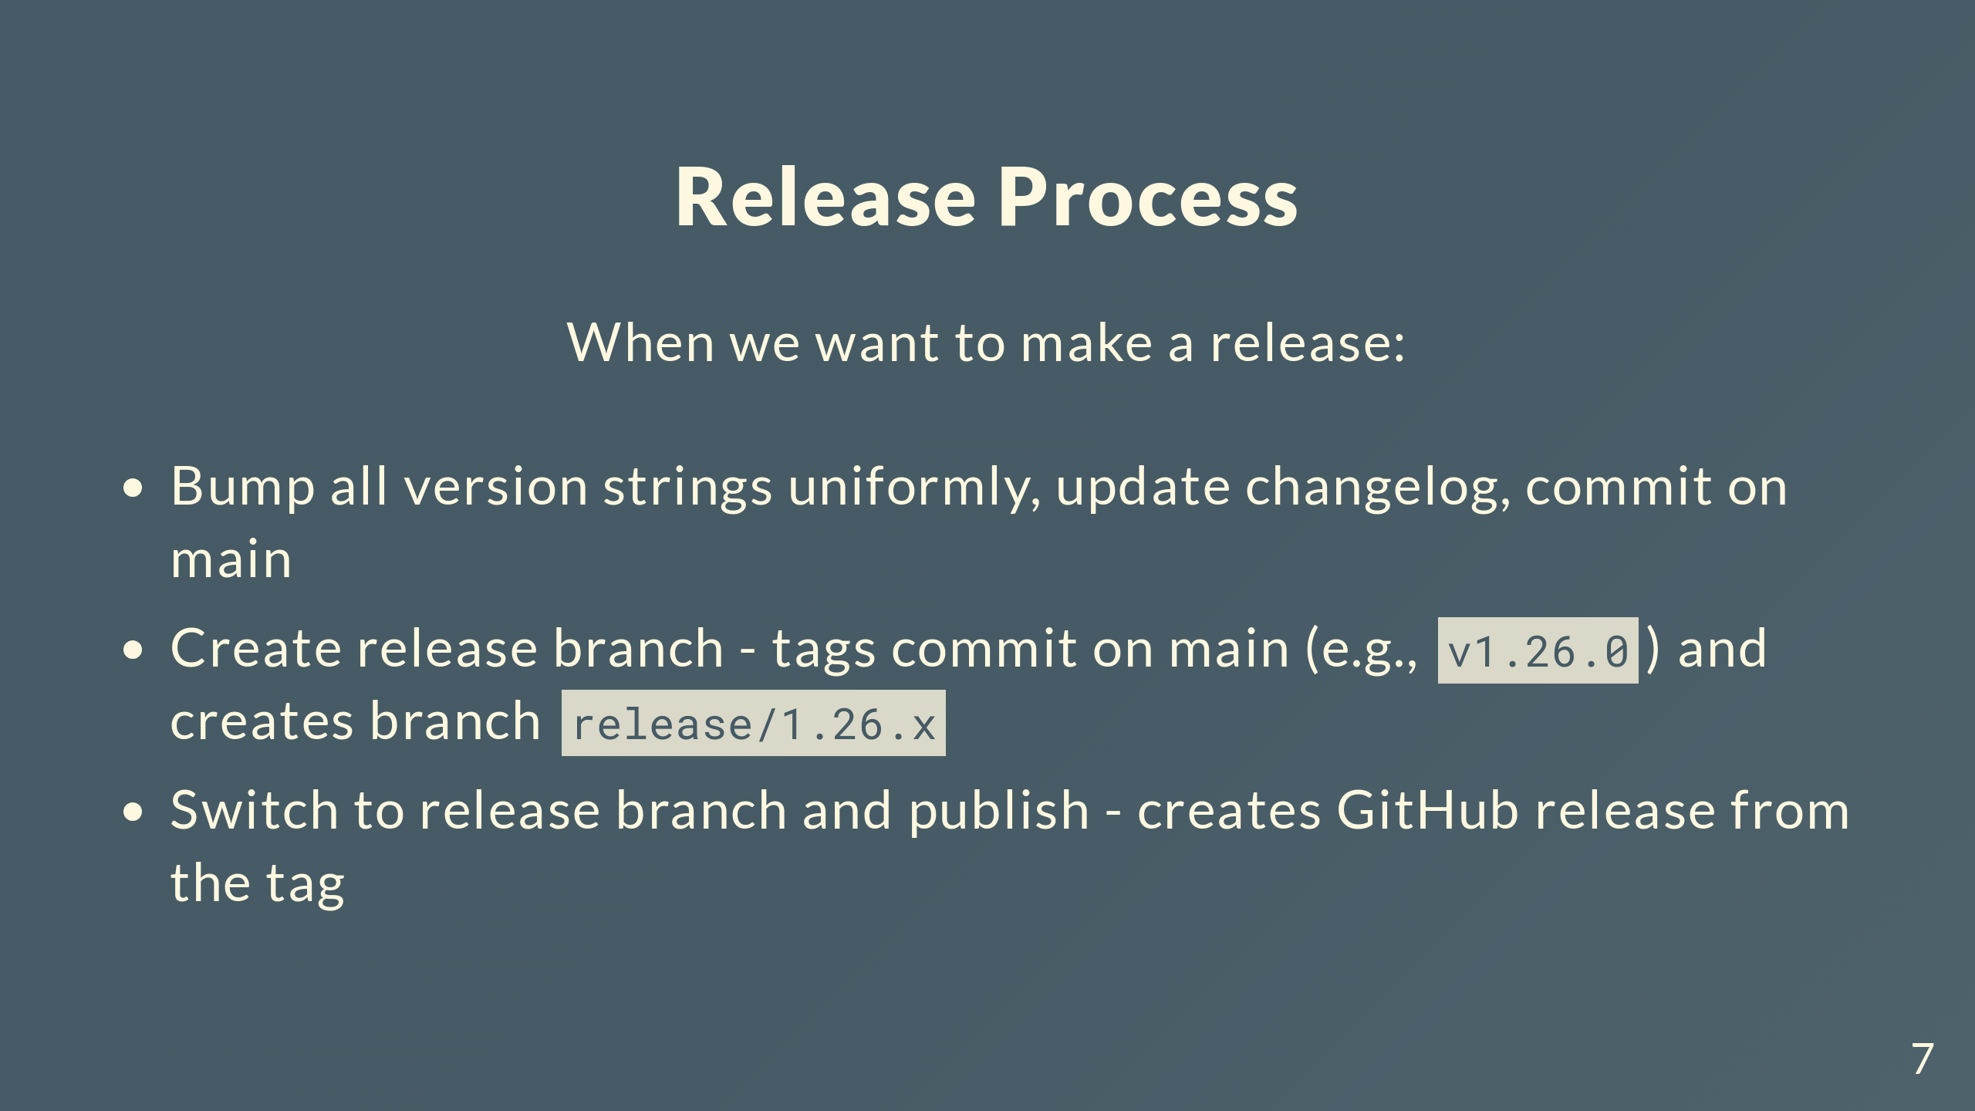
Notes:
Three steps. Bump all versions on main and commit. Create release branch - tags that commit with v1.26.0 and makes the branch from it. Switch to release branch and publish, which creates the GitHub release using that tag.

Slide 8
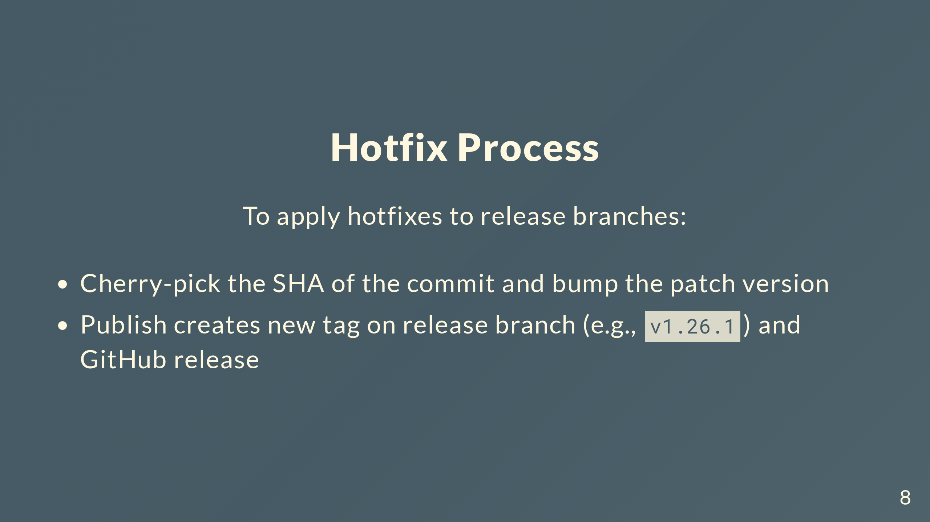
Notes:
Two steps for hotfixes. Cherry-pick the commit and bump patch. Publish creates a new tag on the release branch plus the GitHub release.

Slide 9
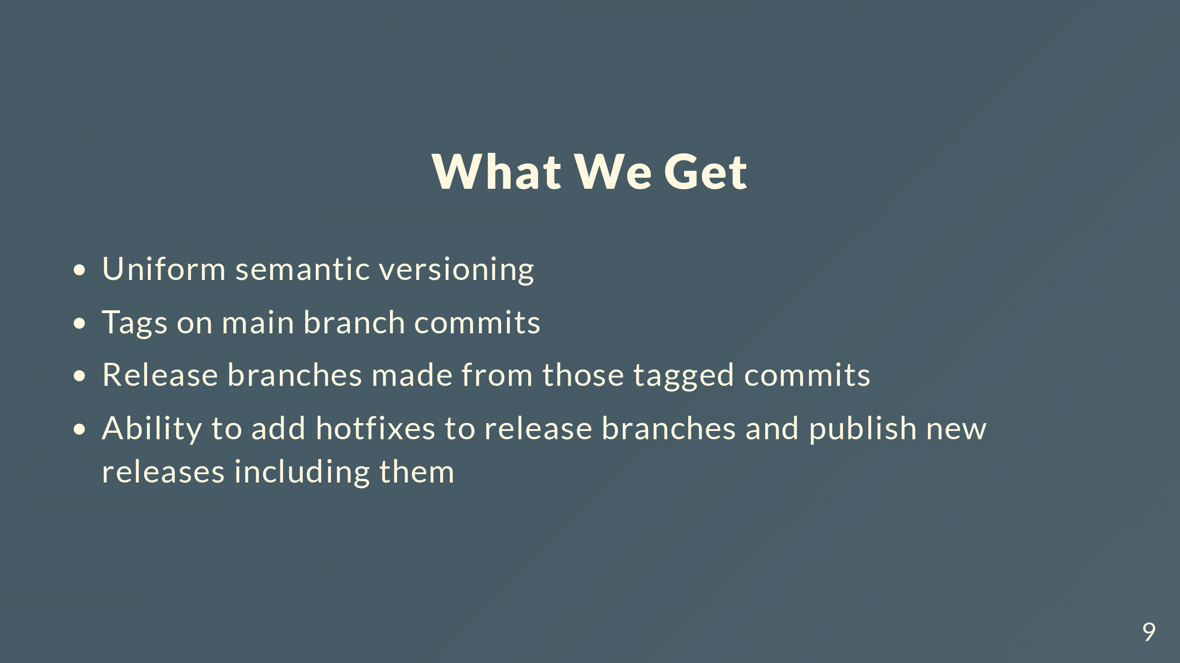
Notes:
End result: unified versioning everywhere, tags on main marking release points, release branches from those tags, clean hotfix workflow.

Slide 10
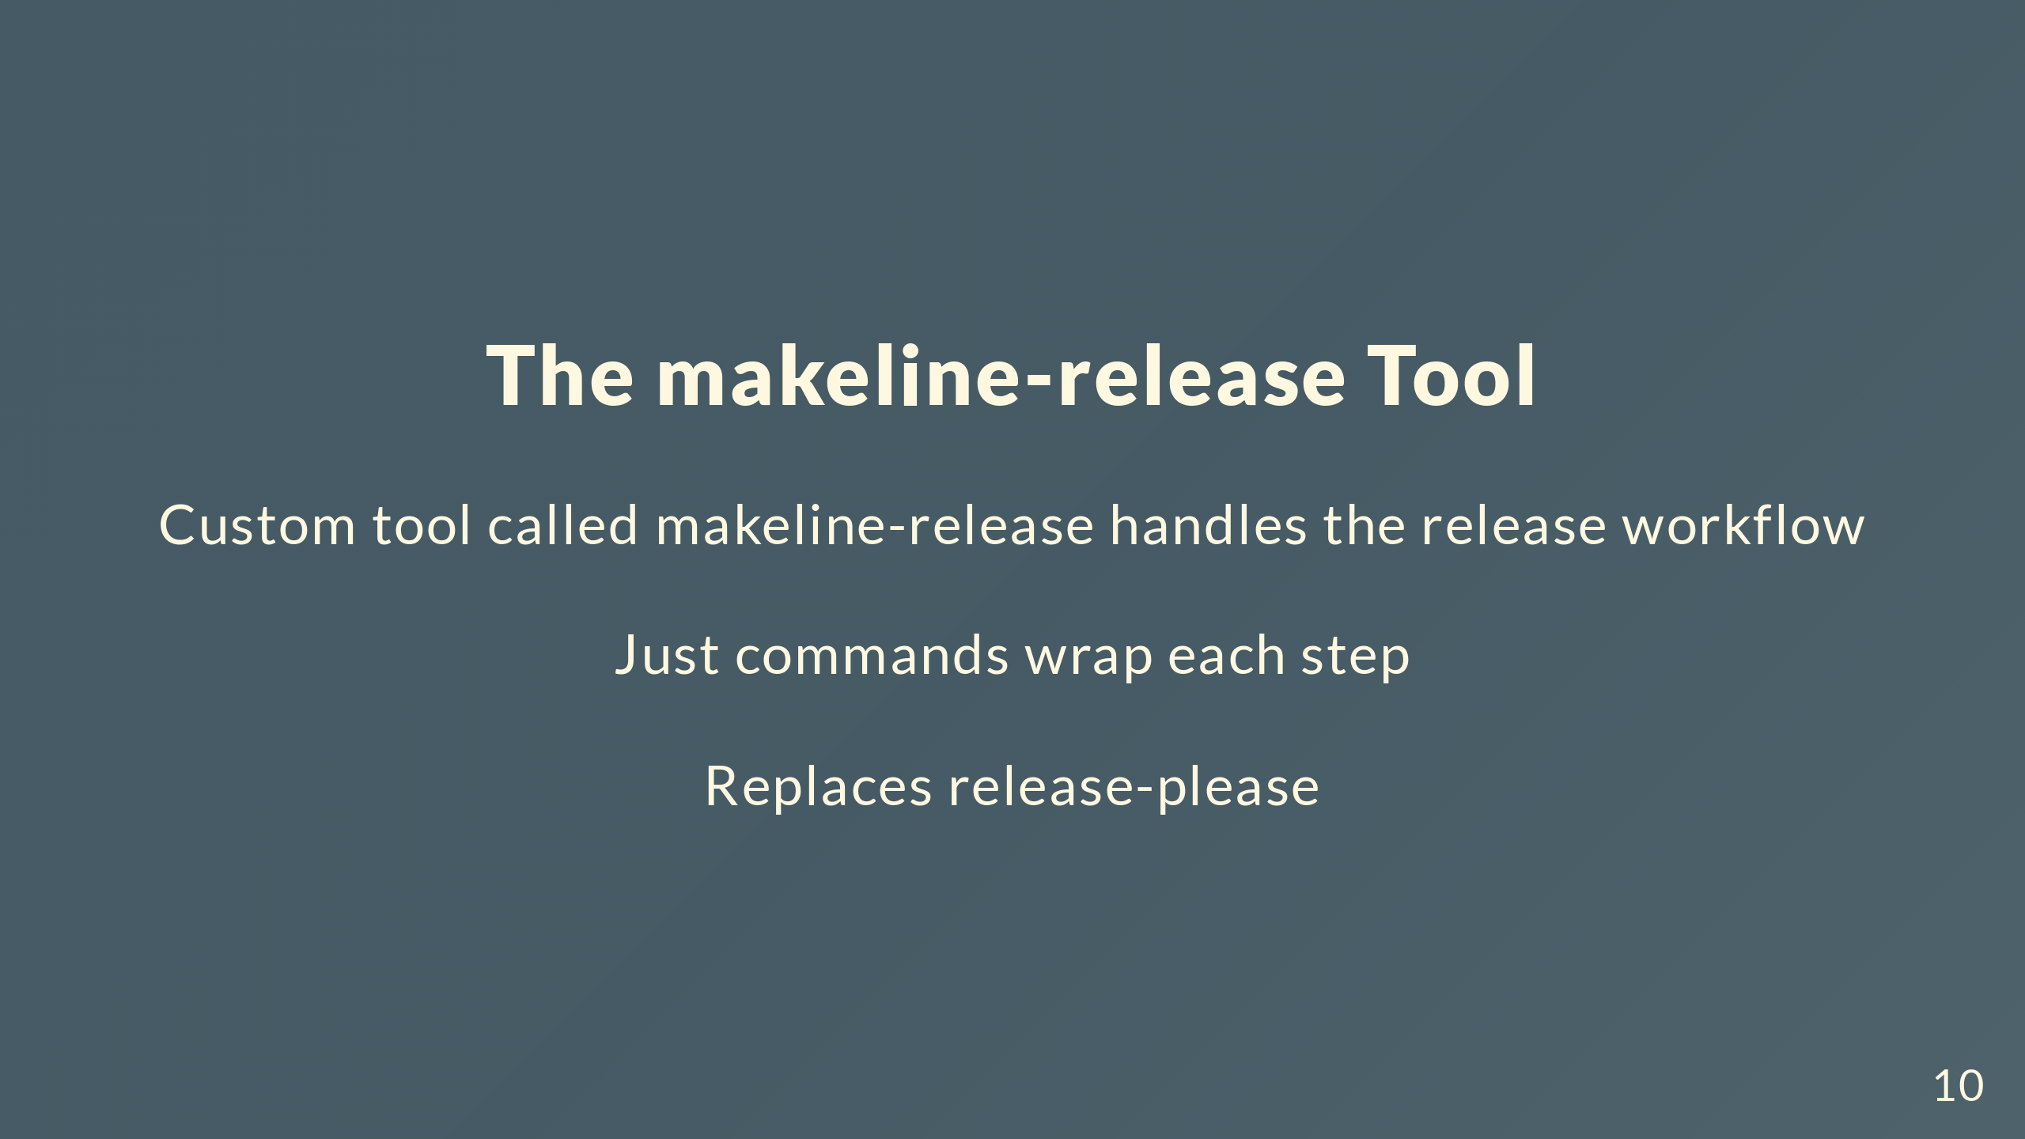
Notes:
Built makeline-release to handle version bumps, tagging, and branch creation. Wrapped in Just commands for convenience. Replaces release-please.

Slide 11
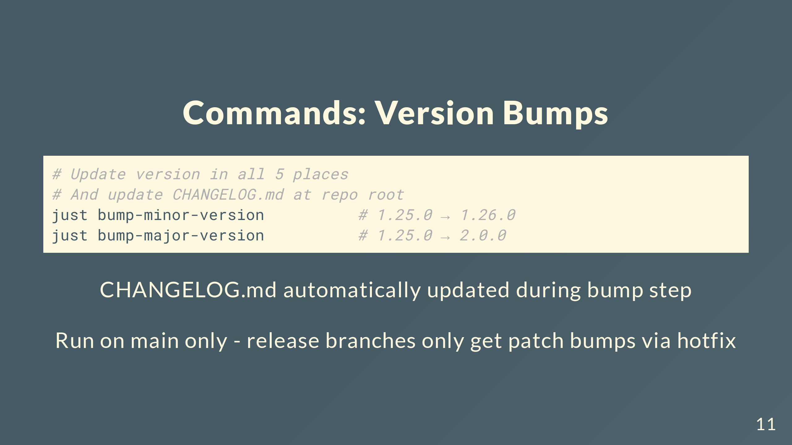
Notes:
One command updates all 5 version files and regenerates the changelog. Everything stays synced. Minor and major bumps only happen on main. Release branches only get patch bumps through the hotfix workflow.

Slide 12
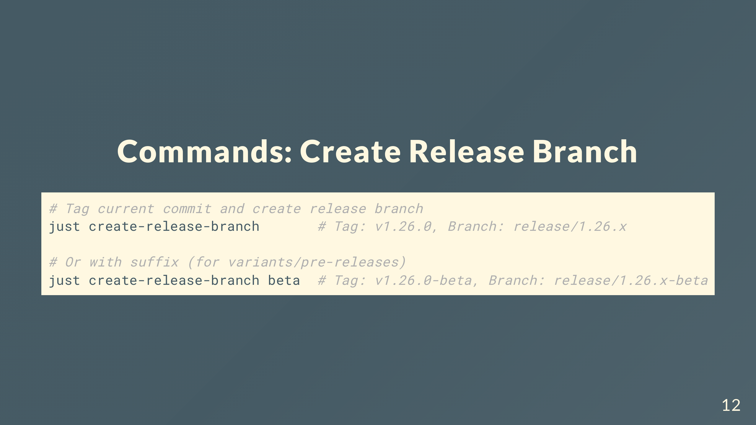
Notes:
Tags current commit on main, creates release branch from that tag, and switches you to that branch. Tag on main marks the release branch creation point. Suffix goes in both tag and branch names. Can create multiple release branches from same commit with different suffixes - each gets its own tag.

Slide 13
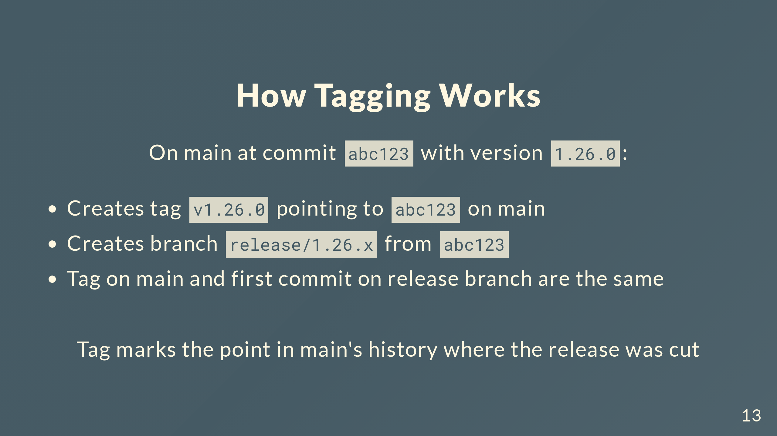
Notes:
When you create a release branch, you're on main at some commit with the version already bumped to 1.26.0. The command creates a tag pointing to that commit on main, then creates the release branch starting from that same commit. So the tag on main and the first commit of the release branch are identical. The tag stays on main marking where in main's history this release came from. Later when hotfixes get applied to the release branch, they diverge, but the tag on main still points to the original release point.

Slide 14
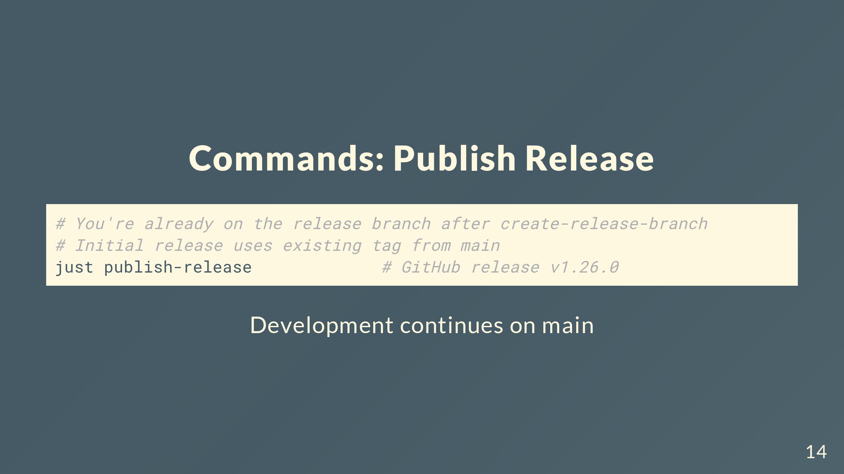
Notes:
After creating release branch you're already on it, so just run publish. For initial release, uses the tag created on main - no new tag. For hotfixes, creates a new tag on the release branch. Tags on main mark where release branches were created. Tags on release branches mark hotfix releases. Main keeps moving forward independently.

Slide 15
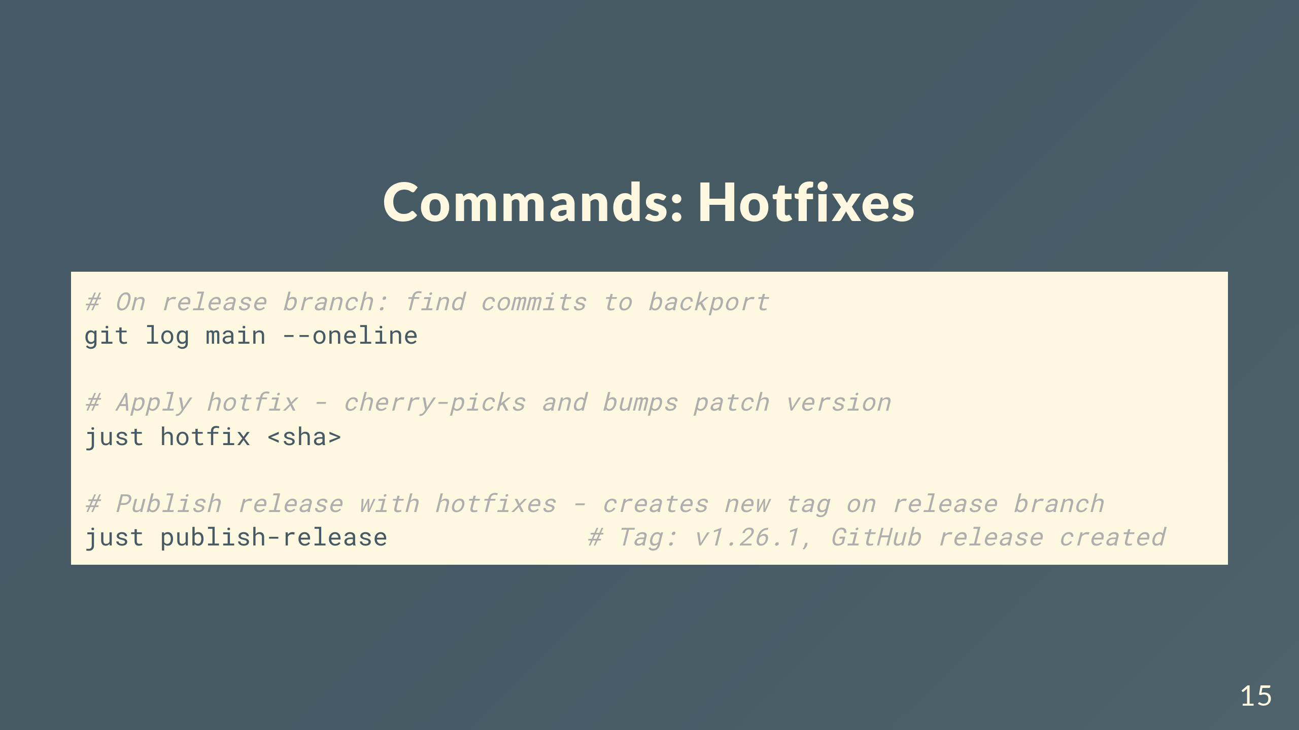
Notes:
From release branch, find the commit SHA on main to backport. Run just hotfix - cherry-picks and bumps patch automatically. Then publish creates new tag on release branch and GitHub release.

Slide 16
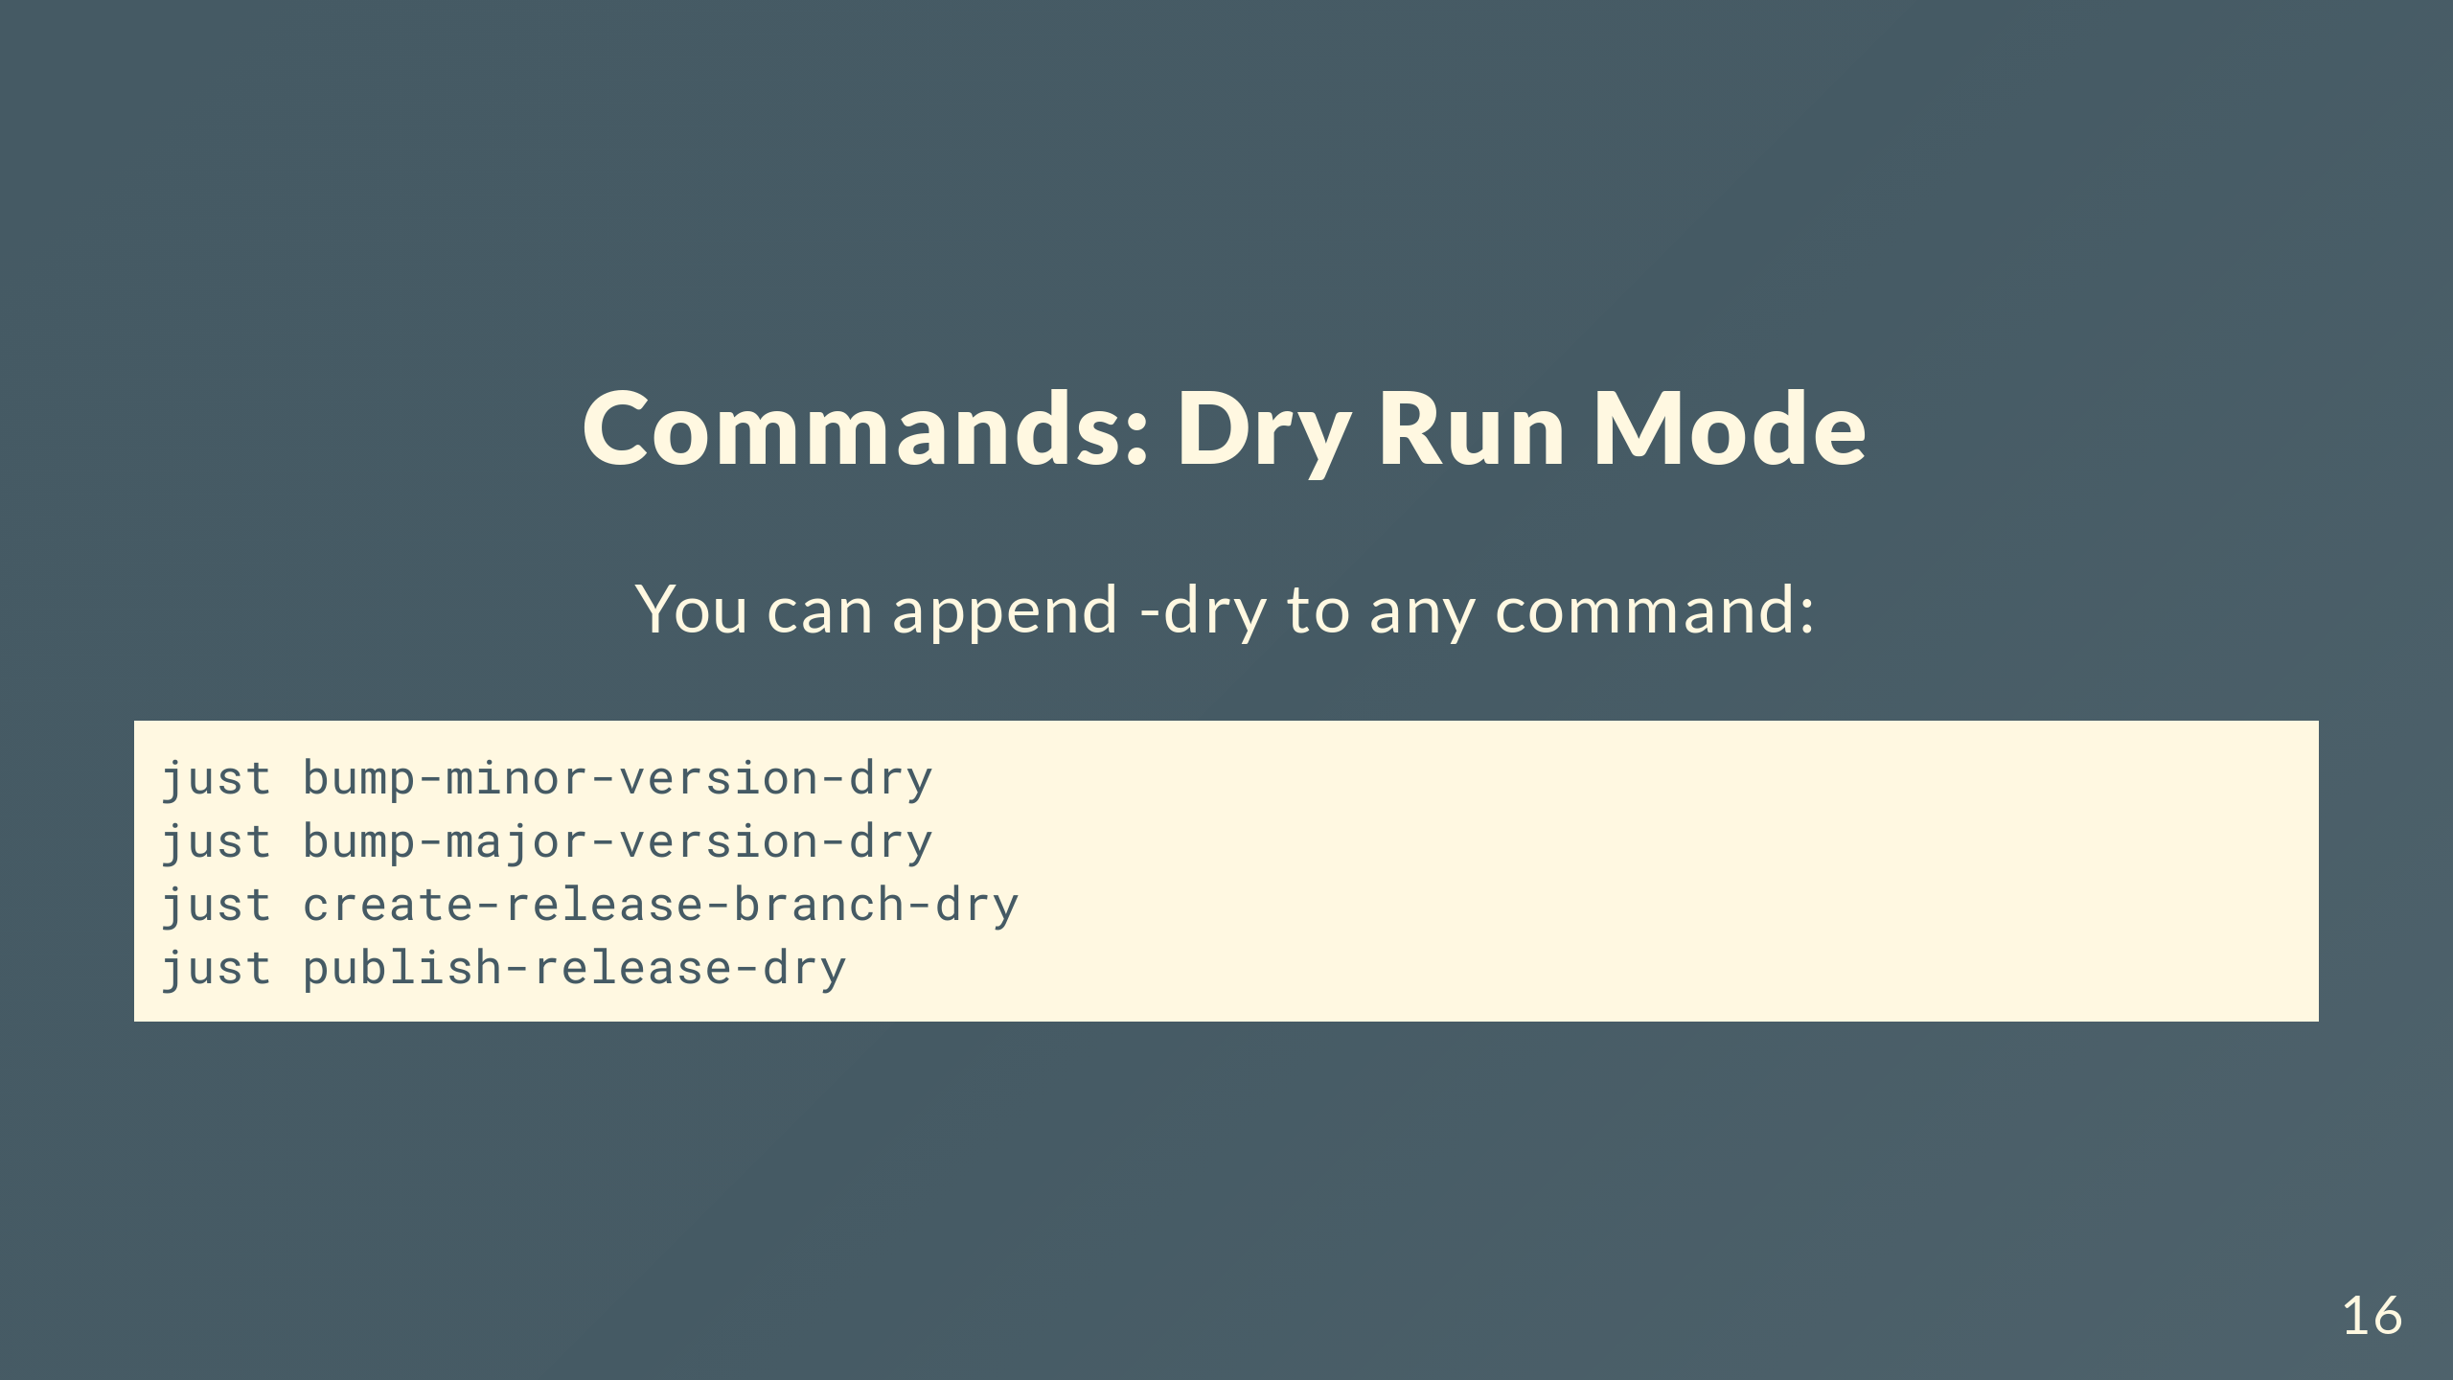
Notes:
All commands support dry run. See what'll happen before committing to changes.

Slide 17
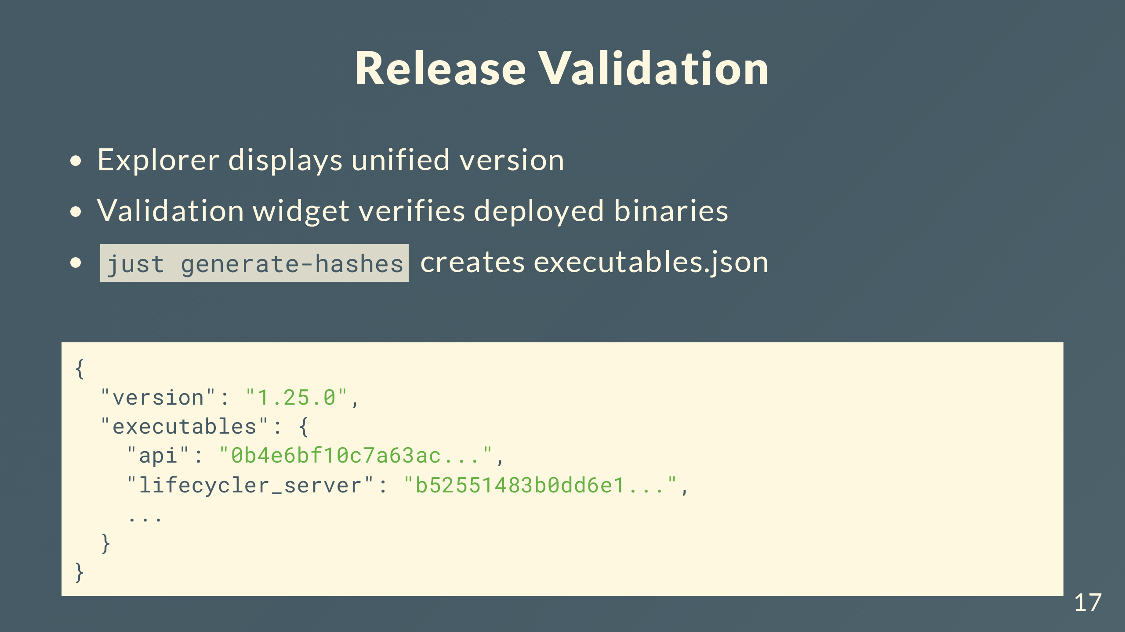
Notes:
Explorer displays the unified version it was built with and the current system version after connecting to a device. The validation widget verifies release integrity using executables.json - a manifest created by running just generate-hashes that maps executable names to their SHA256 hashes. Explorer uses this to verify release artifacts match what was actually built.

Slide 18
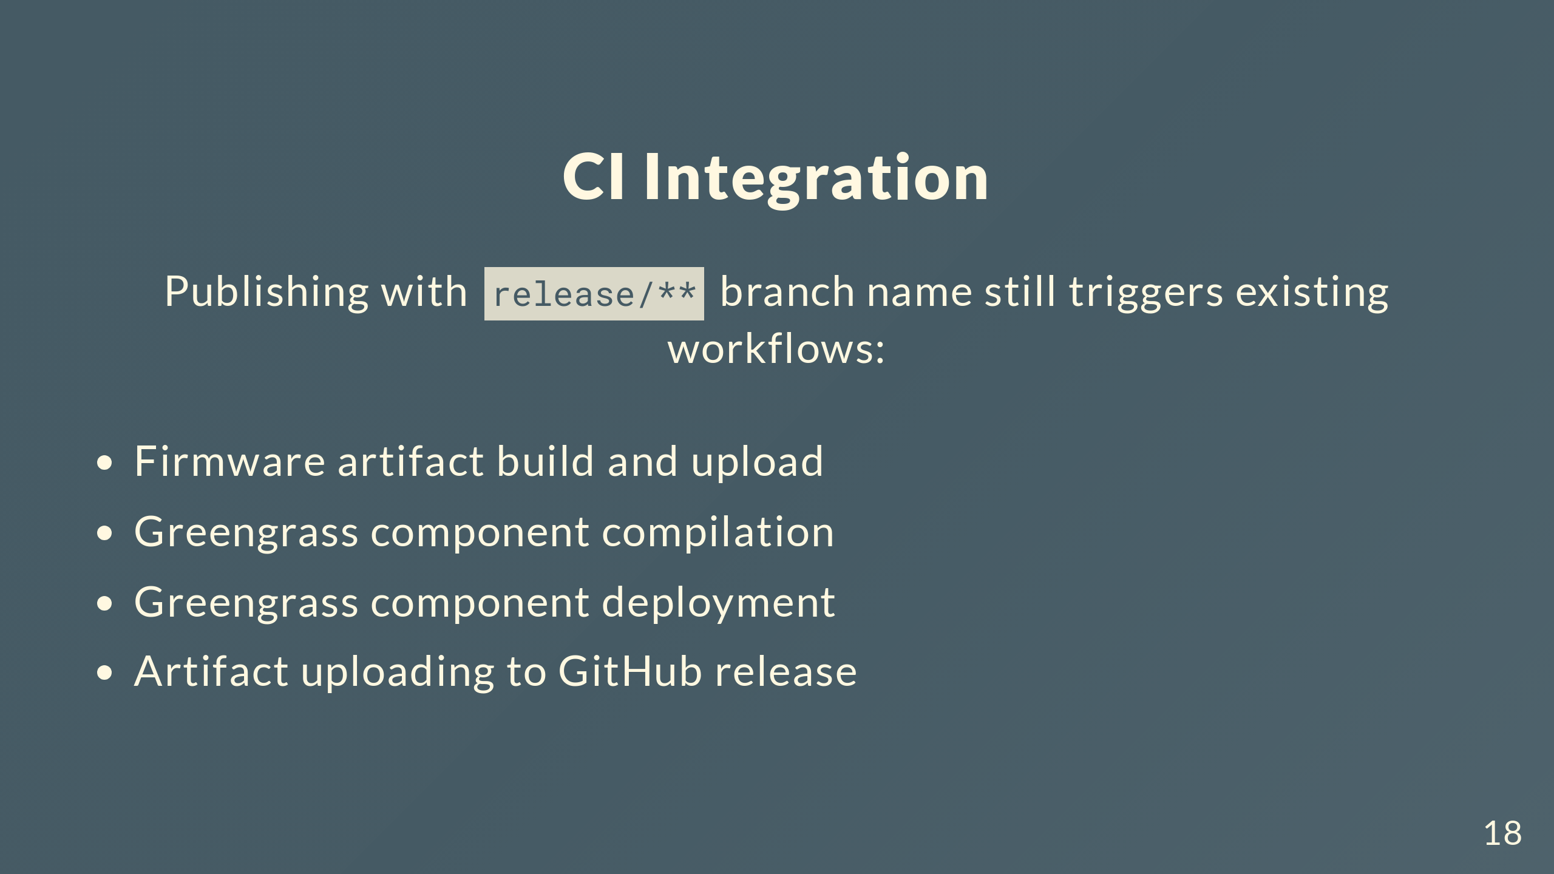
Notes:
Publishing from a release branch triggers existing CI - firmware artifacts, Greengrass component builds and deployments, artifact uploads. Nothing changes on the CI side.

Slide 19
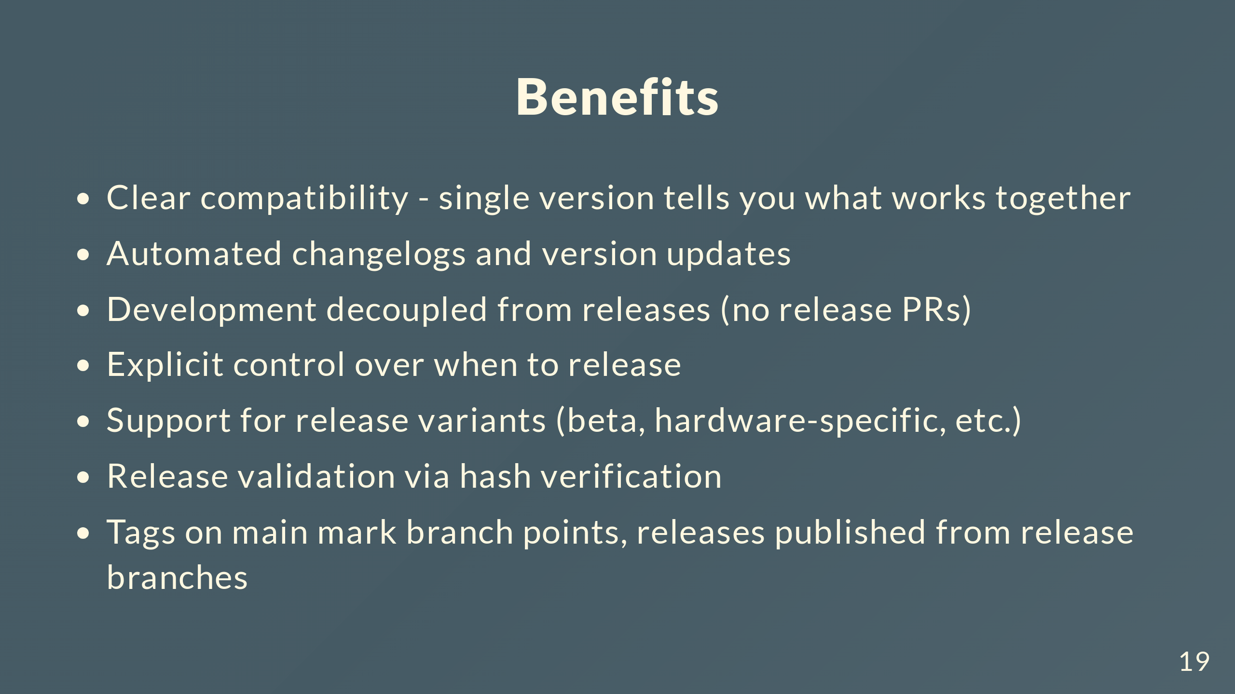
Notes:
Key benefits: compatibility clarity through unified versioning, automated changelogs and version updates, no release PRs at all, explicit release timing, support for variants with suffixes, hash-based validation, tags on main mark where release branches start and all actual releases get published from release branches. Automation where useful, control where needed.

Slide 20

Notes:
That's the new release strategy. Questions?

